Slide 1

Pakalo
Artificially Intelligent Cooking Assistant
FYP-II Pre-Job Fair Evaluation
Abid Waqar i16-0229
Mashood Ur Rehman i16-0063 Supervisor
Nauraiz Mushtaq i16-0106 Dr. Omer Beg

Slide 2
Project Overview
1.
At a Glance

Slide 3
A Chatbot
An Assistant
A Social Platform

Slide 4
Goals and Objectives
2.
Project at the end of FYP-II

Slide 5
Faculty Feedback
3.
Simple grammatical and diagrammatical errors in report

Slide 6
FYP-1 Recap
4.

Slide 7
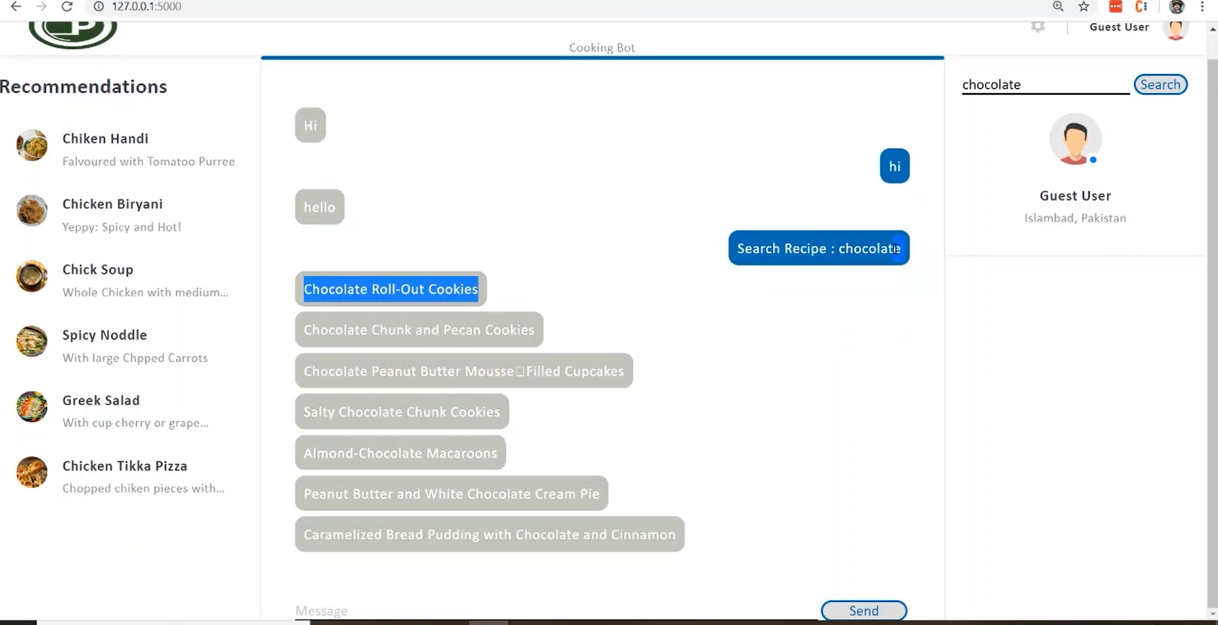
LSTM Bot

Slide 8
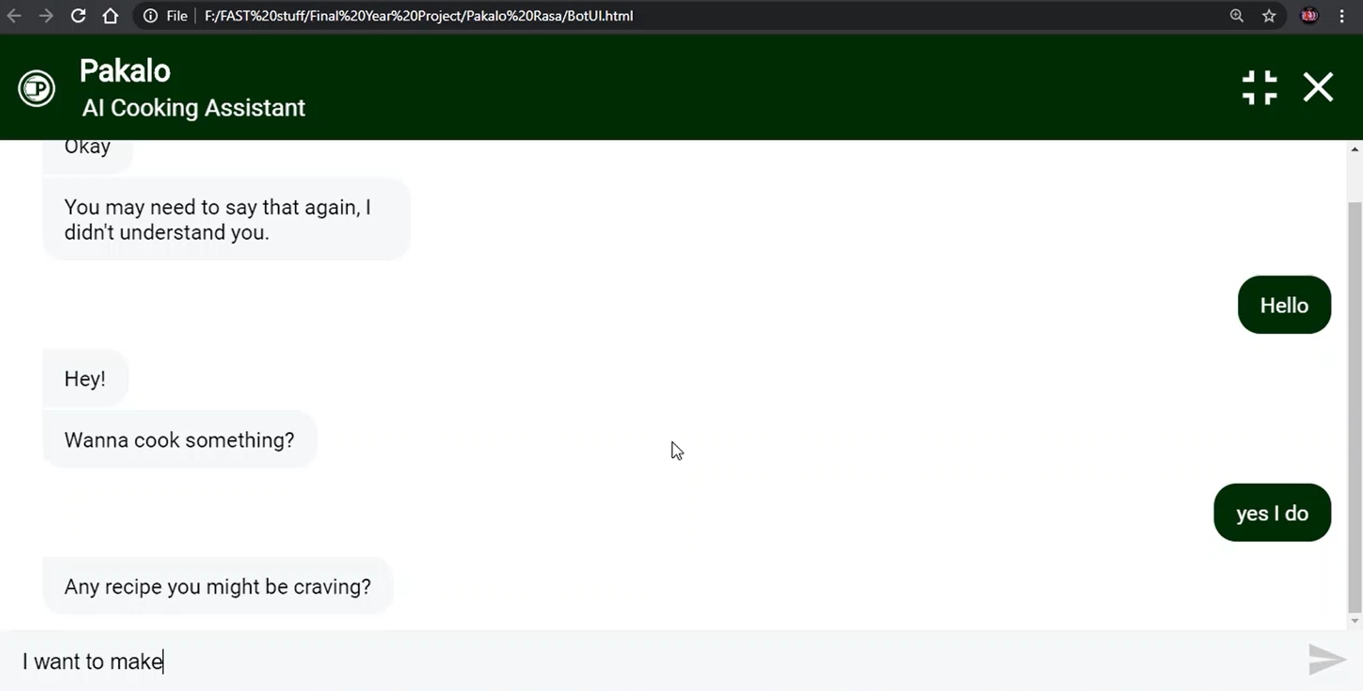
RASA Bot

Slide 9
FYP-II Use Cases
5.
Iteration Three Work Done

Slide 10
Use Cases:
Login
Signup
Recommend Recipes
Assistant Guide

Slide 11
Next Steps
6.
Work we have ahead

Slide 12
Tasks & Challanges
Configuring seamless chat in android.
Recommendation through Knowledge

Slide 13
^{Demo &} ^{Implementation Details}
7.

Slide 14
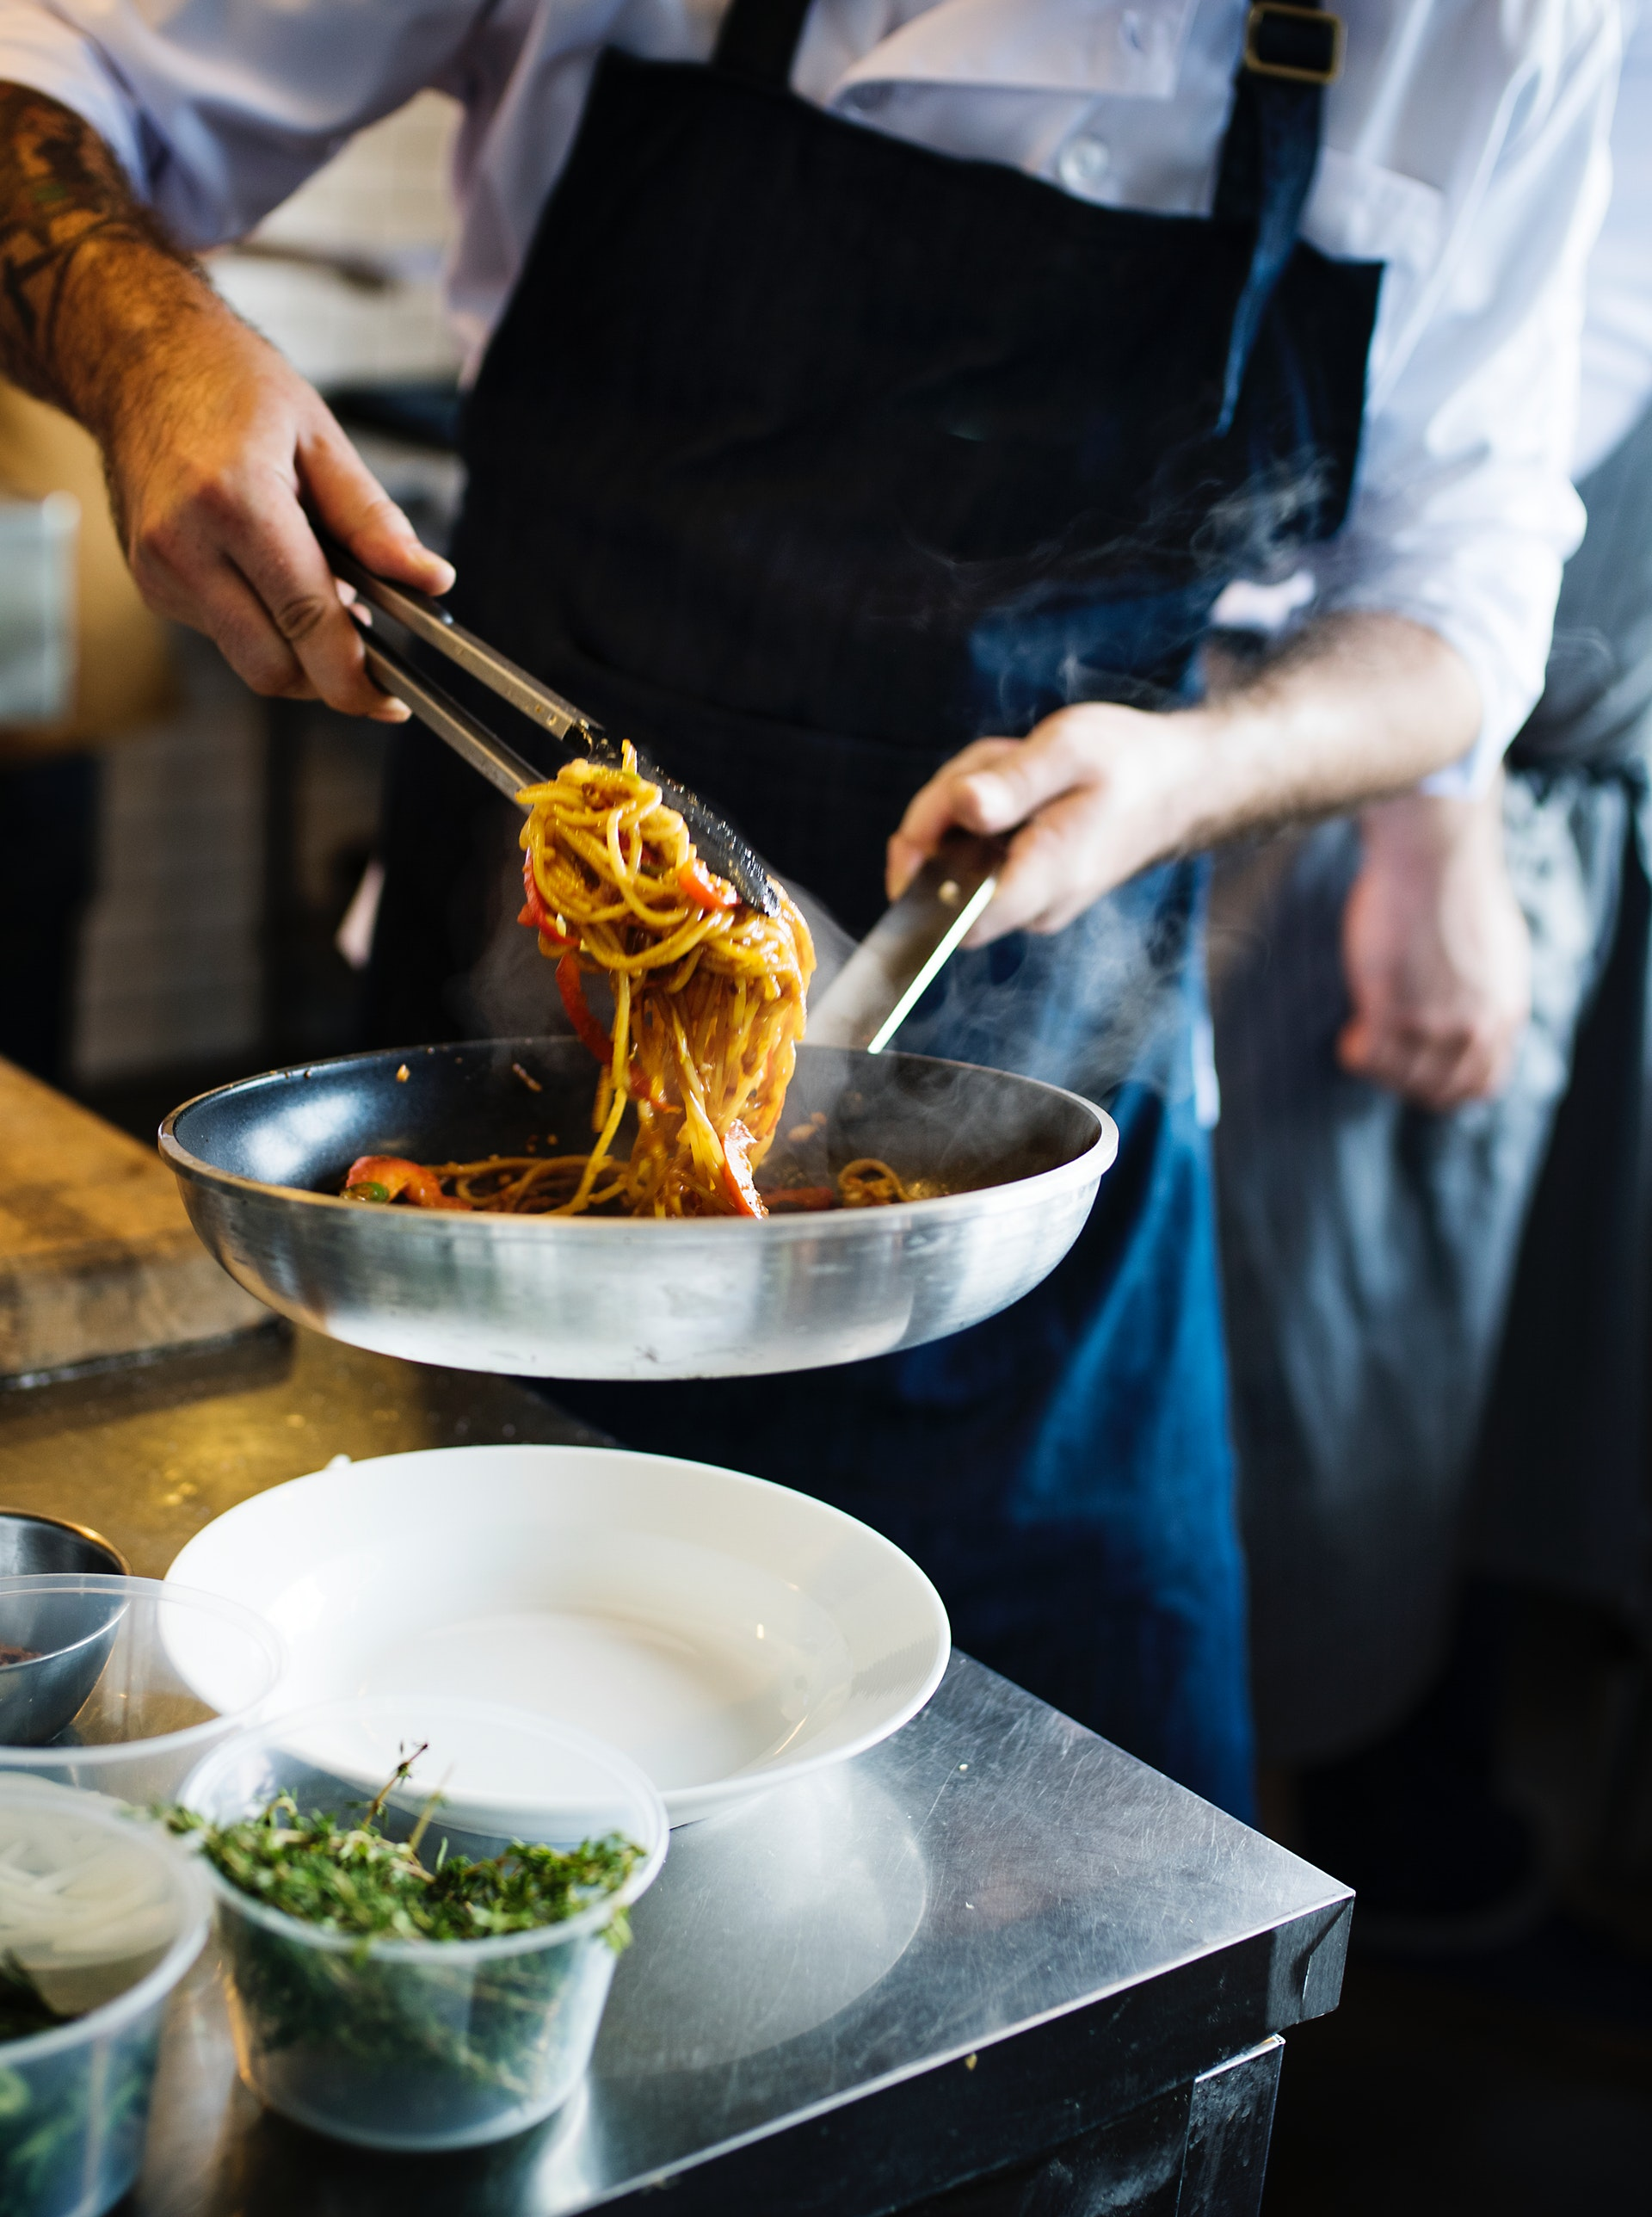
Thank you!
We would love to take any questions now.

Slide 15
Our Timeline
Iteration
One
Iteration Two
Iteration Three
Iteration Four
Data Scraping
Preprocessing
Categorization
September
Model Formation
Model Training
Result Ranking
October, November
Dynamic Learning
Building Mobile Application
December, January, February
Efficient Responsiveness, Feedback
February, March, April

Slide 16
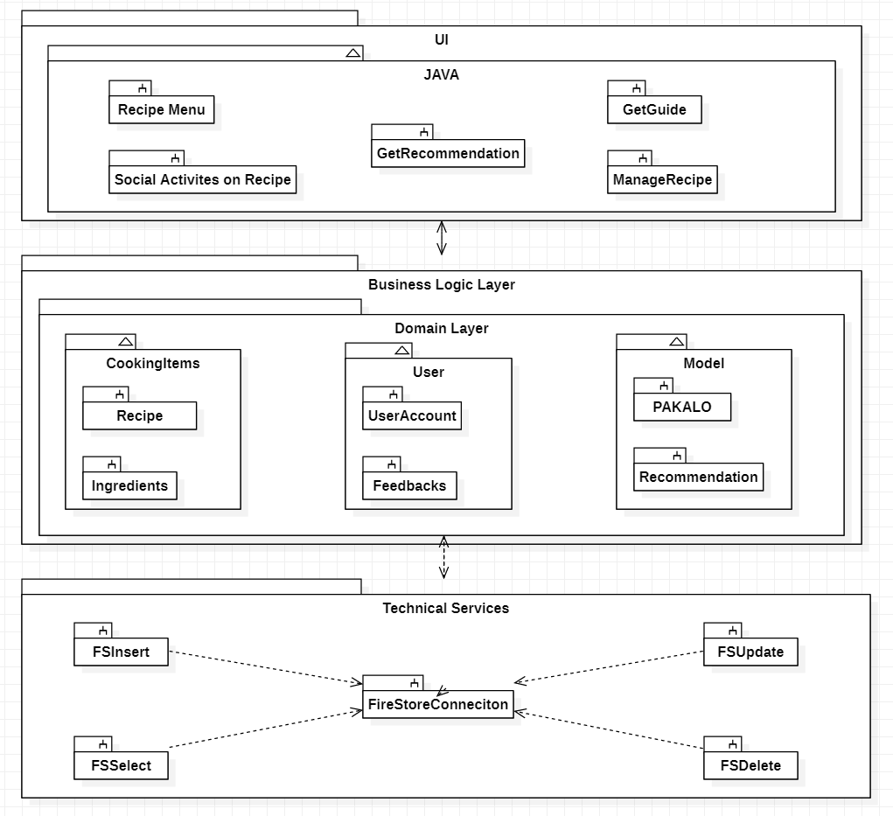

Slide 17
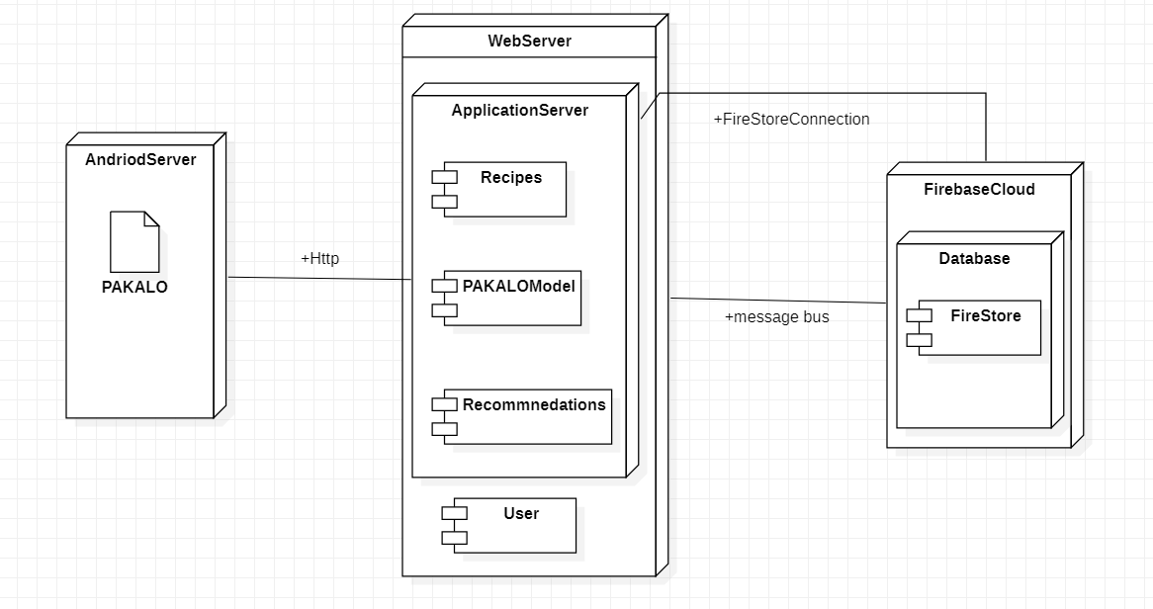

Slide 18
